Slide 1
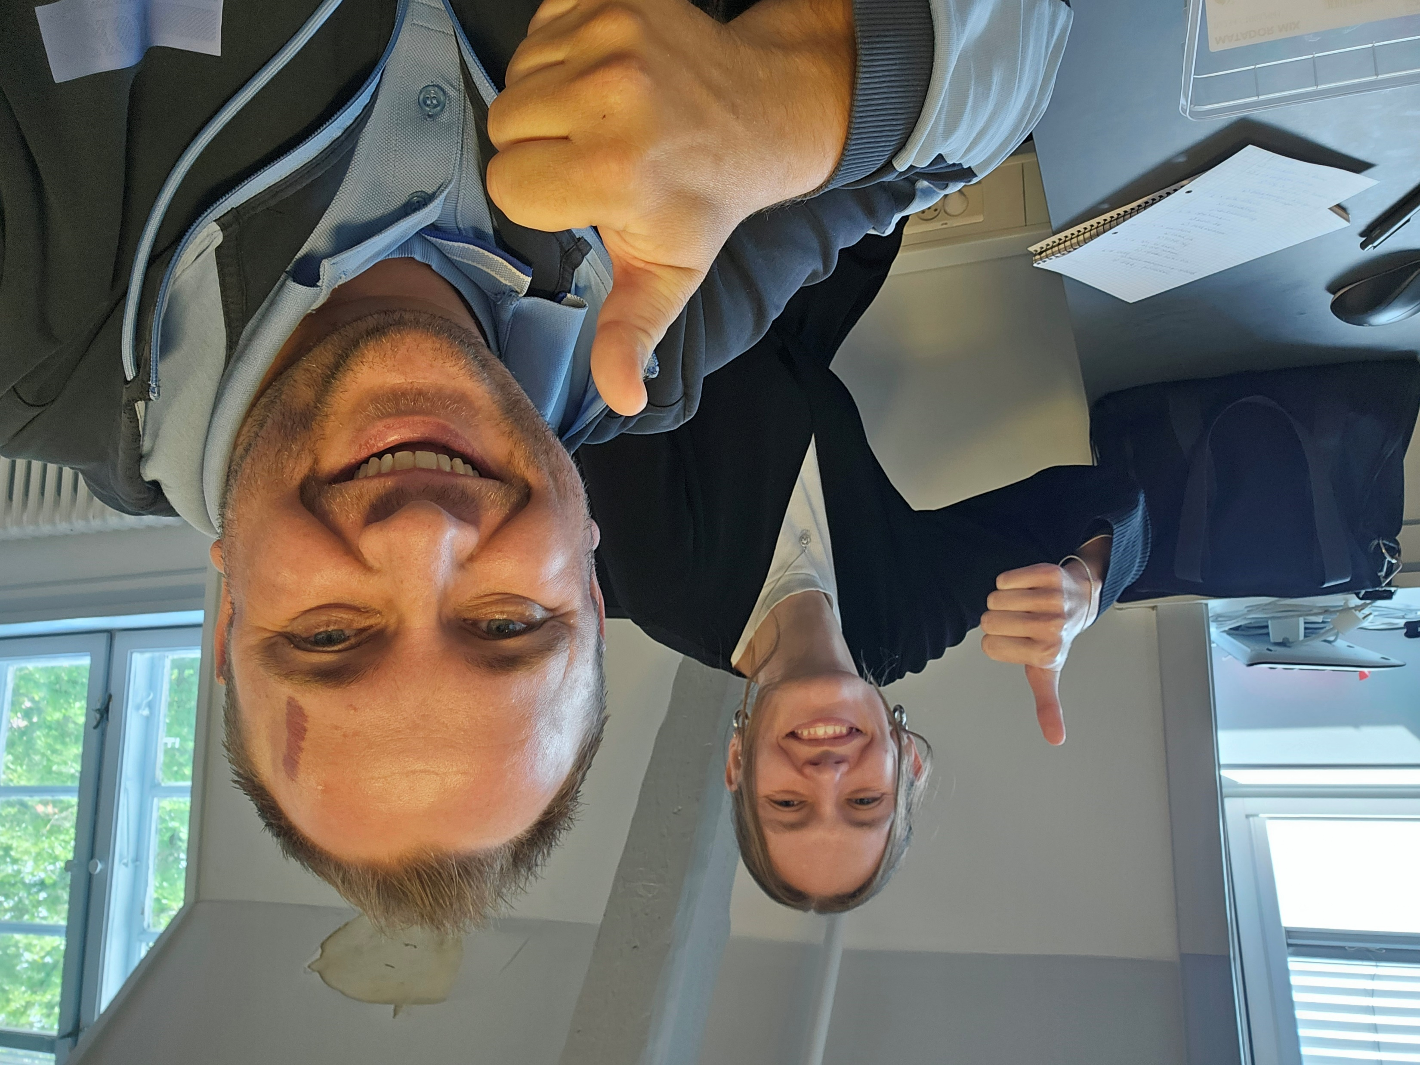
Probably the world’s best heart.dk-quiz
Created by Cæcilie & Mikkel, Nordsjællands Hospital

Slide 2
Introduction
In relation to the heart.dk-network and the most frequently asked questions.
Everybody stand up.
Go in the direction of the arrow for the statement you agree with the most.

Slide 3


The server is slow… What do I do?
I call Statistics Denmark’s hotline, the data manager and/or my supervisor and ask them to sort it out.
I open the task manager and find out if any users are taking up more than > 100,000 mb memory or a large part of the CPU.
I find the user’s name on the user list, and I write to them directly.

Slide 4
I have to write a ethics paragraph in my research article. Which of these are correct?
Approval to use the data sources for research purposes was granted by the data responsible institute in the Capital Region of Denmark. In Denmark, register-based studies that are performed for the sole purpose of statistics and scientific research do not require ethical committee approval or patient consent, in accordance with the Danish Data Protection Act and the General Data Protection Regulation (GDPR).
The study was granted permission to be conducted by the Danish Data Protection Agency (Journal number: 2014–41-2842). In Denmark register-based studies that are pseudonymized do not require informed consent or ethical approval.

Slide 5
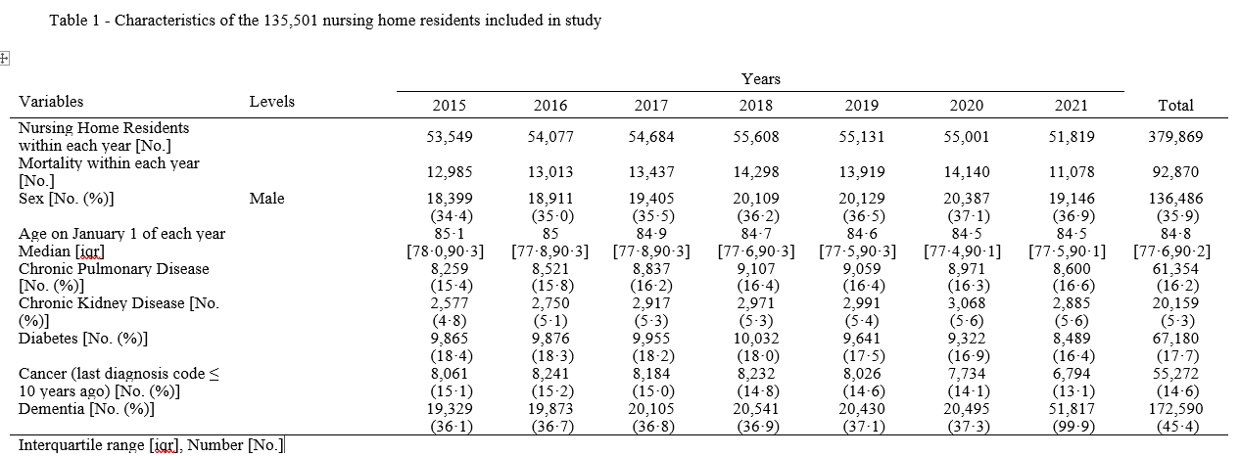
You want to export this table. Can you?
Yes
No

Slide 6
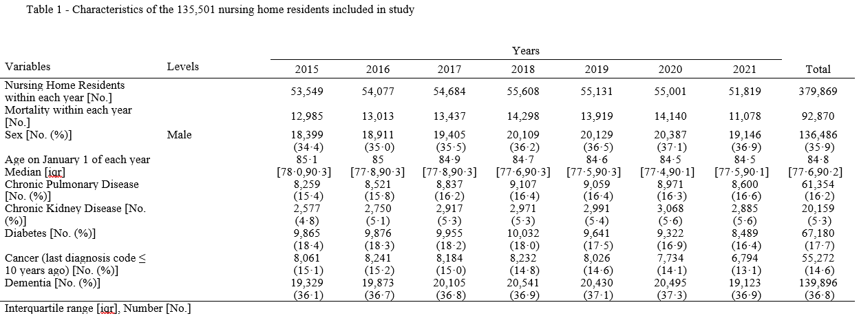
You want to export this table. Can you?
Yes
No

Slide 7


I want to know how a specific dataset is constructed. What do I do?
I go to the Basic Project Data Structure-file and look for the answer.
I call Statistics Denmark or the data manager and ask them about the data structure.

Slide 8


I could really use an RKKP database for a study. How do I get it?
I go directly to the RKKP website, fill out the application form, and I send it or ask the data manager about the process.
I check the FAQ-file on heart.dk to find if there is relevant information on how to apply for data at RKKP.

Slide 9


I’m starting a new project, and I need specific data. How do I get started?
I write to the data manager, describe my project, and he then grants me access to the best suited project folder.
I go to the GitHub repository and look through the approved data. Here I find the project folder that matches my project best, and I ask my Older to grant me access to the project folder.

Slide 10


I forgot to fill out the annual RedCap-survey, I lost my server access, but I still need to work on the servers. What do I do?
I contact Statistics Denmark or the data manager, so they can grant me access to the project folder again.
I contact my supervisor or Older and ask them to grant me the access.

Slide 11


I made the best code ever on and I want to use it on another project folder. How do I prep it for moving?
I thoroughly read through the code and remove any microdata, and I ask my Older to do the same.
I gather all my files in one R-file and/or one SAS-file, and I send the path to the data manager.
I thoroughly read through the code and remove any microdata, and I ask my Older to do the same.
I send the path to each of the individual files to the data manager.
best_codes_ever_1.R
best_codes_ever_COMBINED.R
best_codes_ever_2.R
best_codes_ever_3.R
best_codes_ever_COMBINED.sas
best_codes_ever_1.sas
best_codes_ever_2.sas
best_codes_ever_3.sas

Slide 12
Reminder!
A couple of times a month we host an online Tour de Statistics Denmark, where we introduce:
Data and data structure
Do’s and don’ts
Task manager
Practical information on server access
Helpful ressources (heart.dk, Grunddatabank and more)
If you are interested in joining the next tour, please send an e-mail to mikkel.porsborg.andersen@regionh.dk

Slide 13

Questions or comments?

